Slide 1

“Team 1”
Analysts:
Andy
Marianna
Reuben
Carla

Slide 2
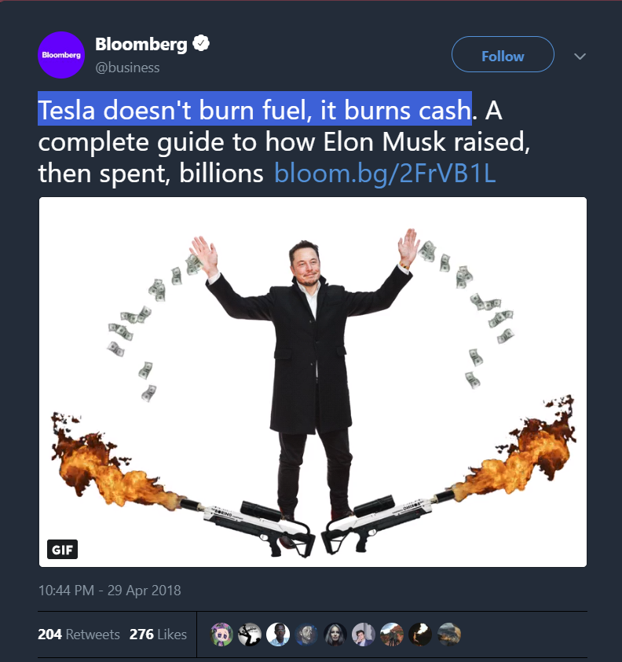
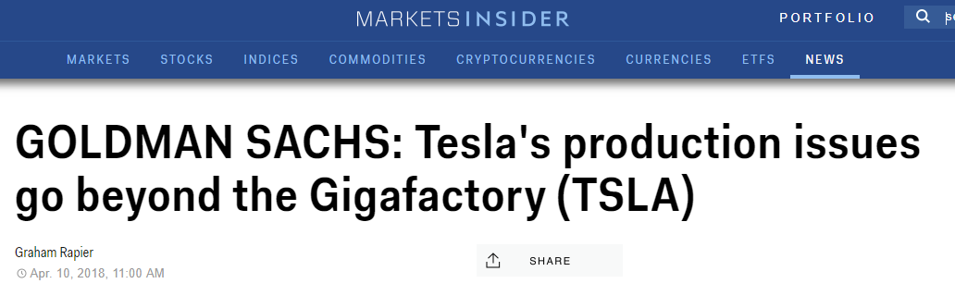
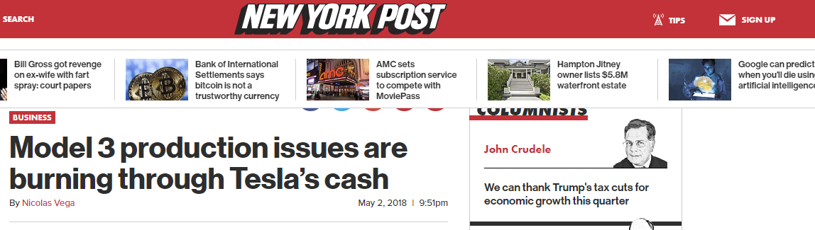
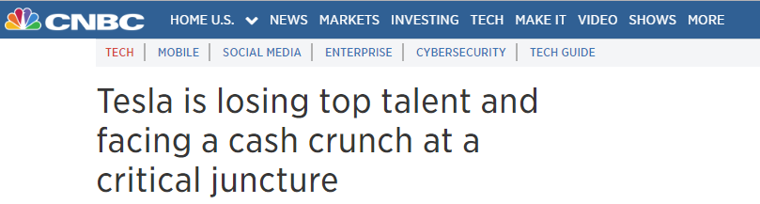

Slide 3
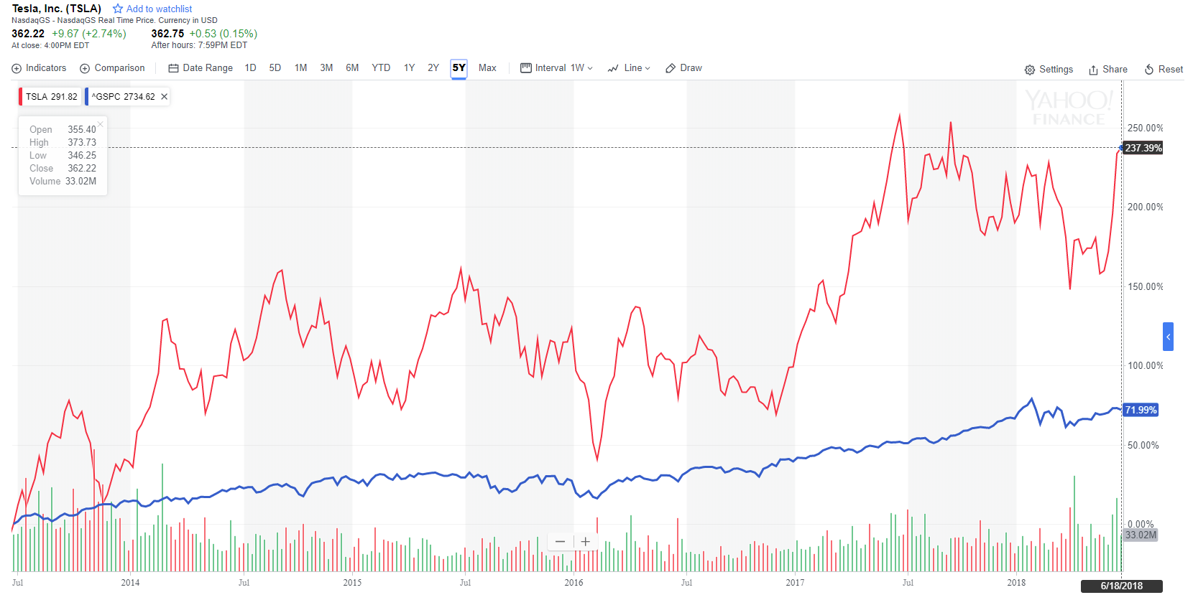



Slide 4
Our Data Sources:
Financial Statements (SEC 10-Q Filings)
Yahoo Finance
Twitter
Zacks.com

Slide 5
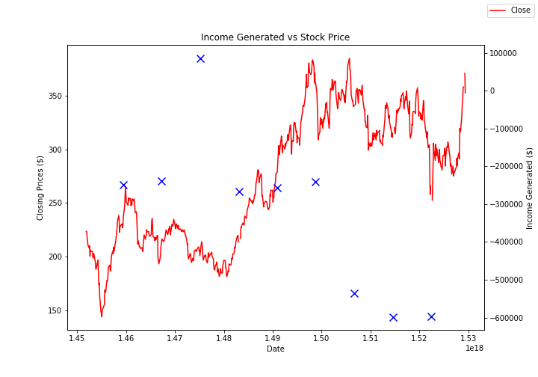

Market Reaction to Earnings (Financials):
Operating Income:
Cash Flows from Operations:

Slide 6
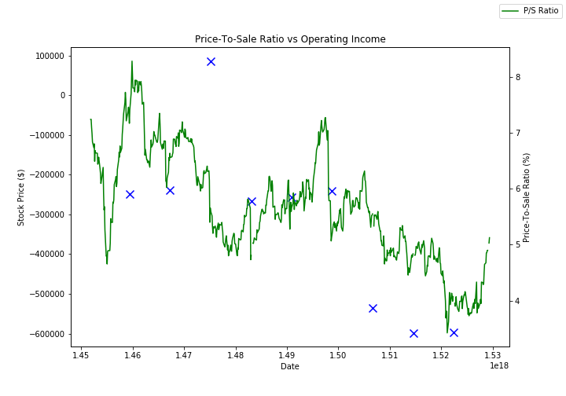
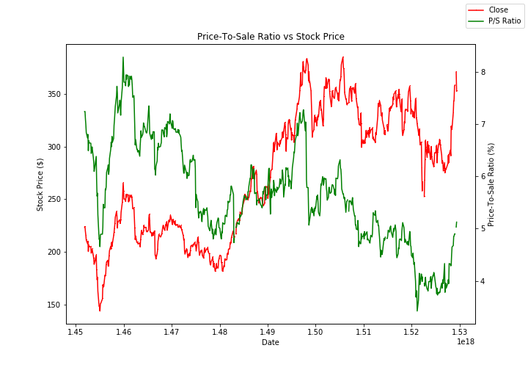
Price/Sale Ratio Against:
Operating Income:
Stock Market Price:

Slide 7
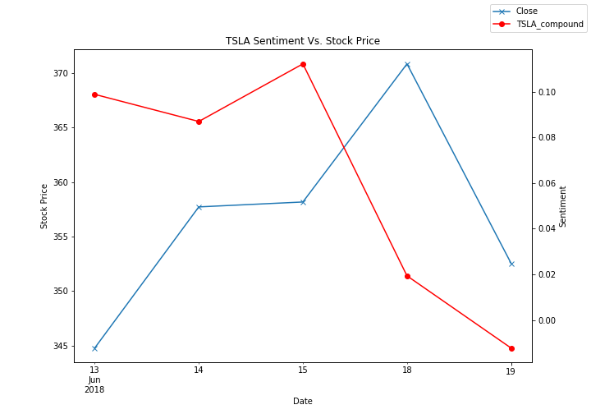
“TSLA” Twitter Sentiment vs Stock Price

Slide 8
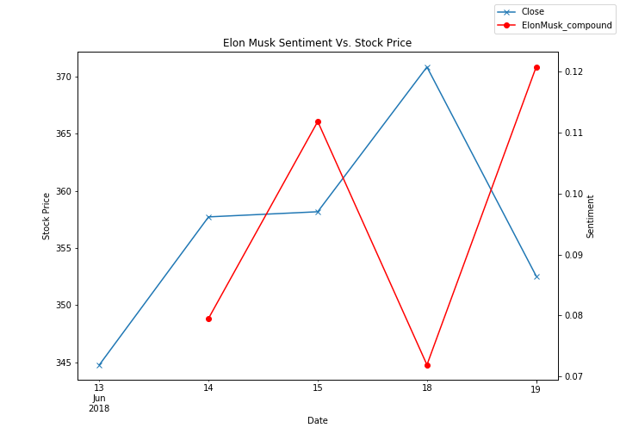
“Elon Musk” Twitter Sentiment vs Stock Price

Slide 9
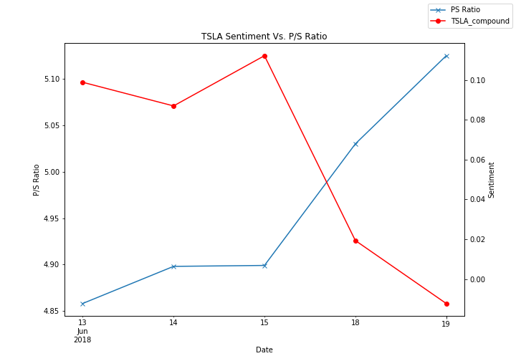
“TSLA” Twitter Sentiment vs Price/Sale Ratio

Slide 10
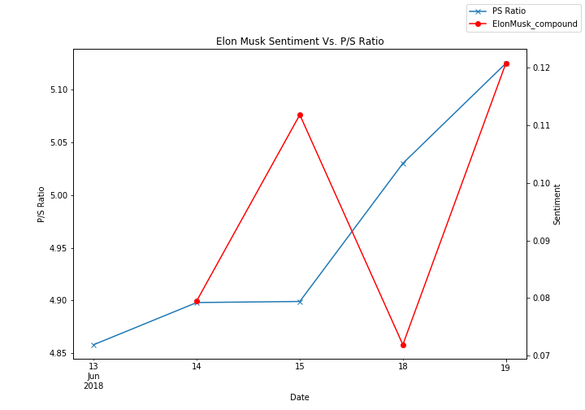
“Elon Musk” Twitter Sentiment vs Price/Sale Ratio

Slide 11
Lessons Learned
Historical twitter data is not easily accessible without a paid license
GMT to PST date conversion
Merging multiple data sources
Plotting with multiple y-axis
Working with various date formats
Understand your underlying data

Slide 12

Thank you!

